Slide 1




Warmly welcome to our class !

Slide 2
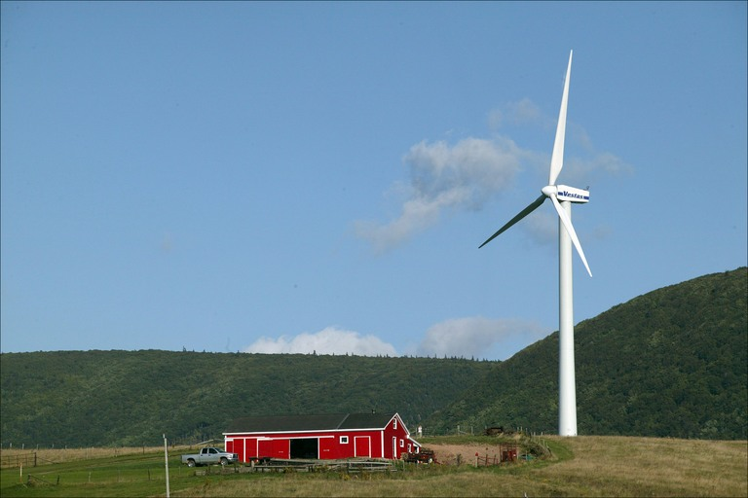
Wind power
Windmill

Slide 3
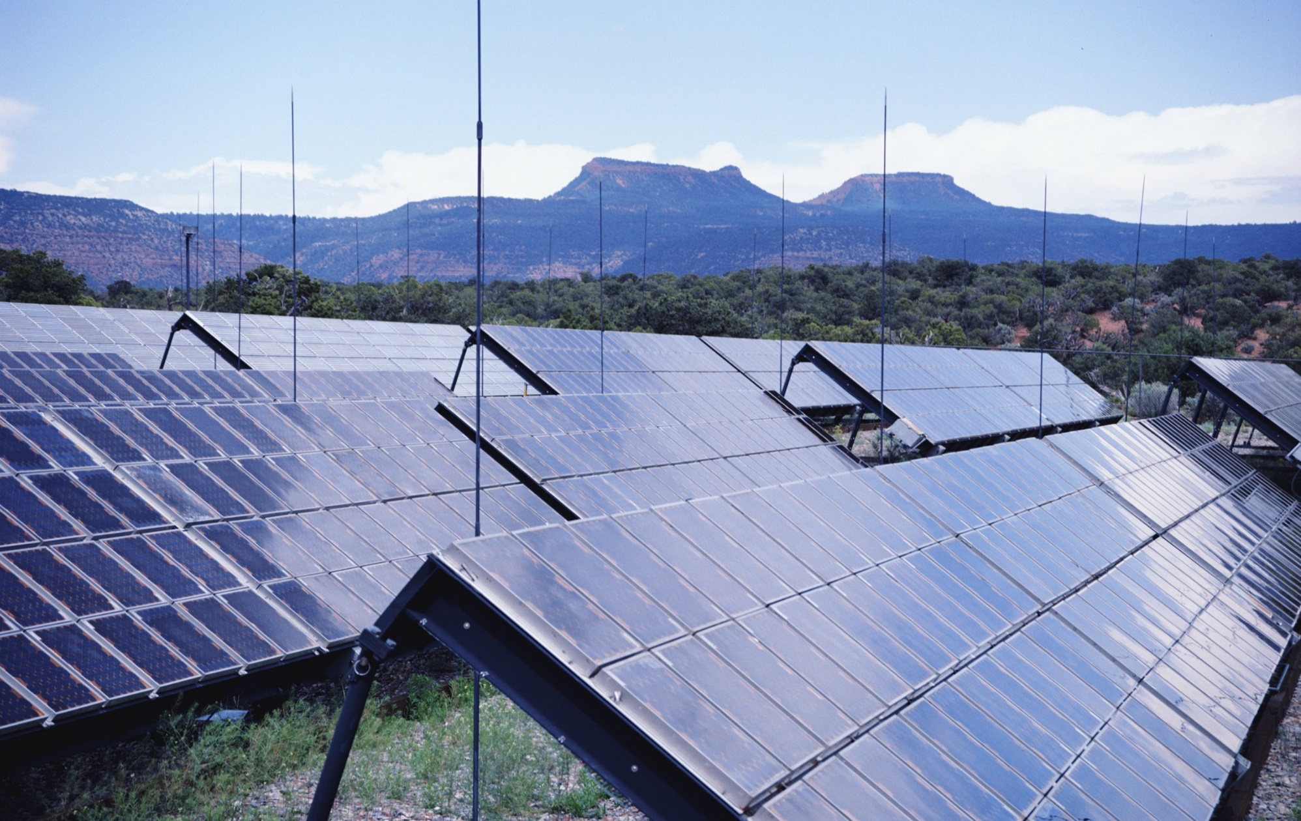
Solar panels
Solar energy

Slide 4
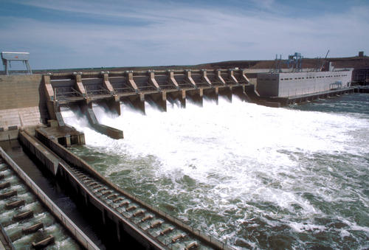
Water Power
Hydroelectric dam

Slide 5
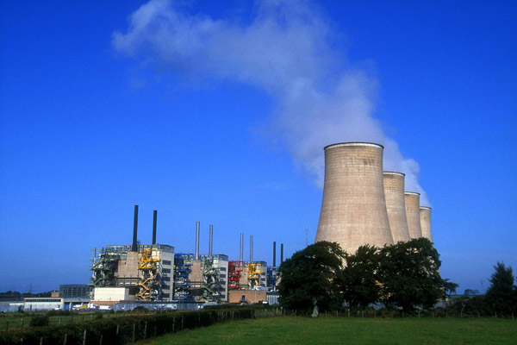
Nuclear Power
Nuclear reactor

Slide 6
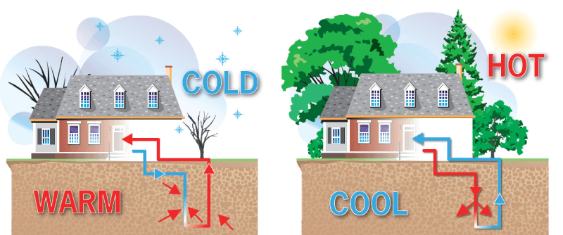
Geothermal heat

Slide 7

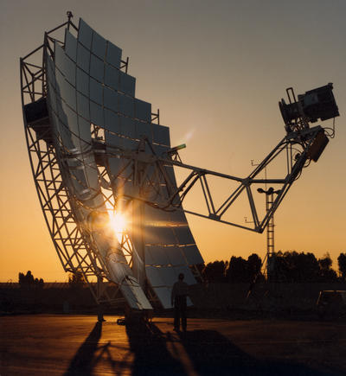
UNIT 11: SOURCES OF ENERGY
Reading

Slide 8
I. Before you read
VOCABULARY
fossil fuel (n):
nhieân lieäu hoùa thaïch
reserve (n):
ñoà döï tröõ ñeå duøng khi caàn
exhaust (v)
laøm caïn kieät
alternative (adj):
thay theá
geothermal heat
địa nhiệt
release (v)
phoùng thích, thaû
infinite (adj)
vô tận
potential (adj)
tiềm năng
limited (adj)
# unlimited (adj)
coù giôùi haïn # voâ haïn

Slide 9
nuclear energy:
năng lượng hạt nhân
solar panel :
tấm pin năng lượng mặt trời
plentiful (adj)
dồi dào

Slide 10
II. While you read
At present, most of our energy comes from fossil fuels (oil, coal, and natural gas). However, such reserves are limited. Because power demand is increasing very rapidly, fossil fuels will be exhausted within a relatively short time. Therefore, people must develop and use alternative sources of energy.
One alternative source is nuclear energy. Nuclear energy can provide enough electricity for the world’s needs for hundreds of years, but it can be very dangerous. Another alternative source of energy is geothermal heat, which comes from deep inside the earth. Scientists use this heat to make energy. However, this energy is available only in a few places in the world.
The sun, water, and the wind are other alternative sources of energy. The wind turns windmills and moves sailboats. It is a clean source of energy, and there is lots of it. Unfortunately, if the wind does not blow, there is no wind energy. When water moves from a high place to a lower place, it makes energy. This energy is used to create electricity. Water power gives energy without pollution. However, people have to build dams to use this energy. And as dams cost a lot of money, water energy is expensive.
The sun releases large amounts of energy every day. This energy can be changed into electricity. Many countries use solar energy for their daily life. Solar panels on the roofs of houses can create enough energy to heat or cool an entire house. Solar energy is not only plentiful and infinite but also clean and safe.
Although there are some disadvantages, the potential of alternative sources of energy is great. However, how to make full use of these sources of energy is a question for researchers all over the world.

Slide 11
II. While you read
Task 1: Fill each blank with a suitable word.
alternative - limited - energy- released - exhausted
released
1. Six hundred balloons were___________ at the ceremony.
2. They are looking for ____________ methods of making it.
3. People use ___________ to run machines, heat and cool their homes.
4. The food in the restaurant is cheap, but the choice is rather_________
5. Fuel supplies are nearly ____________
alternative
energy
limited
exhausted

Slide 12
Task 2: Write down the advantage (s) and disadvantage (s) of each alternative source of energy.
Sources of energy | Advantage(s) | Disadvantage(s)
Nuclear power
unlimited.
can be dangerous.
Solar energy
only possible
during the day time.
not only plentiful &
infinite but also clean
& safe.
clean and unlimited.
Water power
expensive.
clean and unlimited.
no wind → no energy
Wind power
Clean & available.
available only in
a few places.
Geothermal heat

Slide 13
Task 3: Answer the questions
1. What is our major source of energy ?
2. Is our major source of energy limited ? Why / why not ?
3. How many sources of energy are mentioned in the text ? What are they ?
4. Which source of energy do you think has the most potential?

Slide 14


1. What is our major source of energy ?
Our major source of energy comes from fossil fuels.

Slide 15

2. Is our major source of energy limited?
Why / why not?
Yes, it is. Because power demand is increasing very rapidly, fossil fuels will be exhausted within a relatively short time .

Slide 16
3. How many sources of energy are mentioned
in the text? What are they?
Five sources of energy are mentioned in the text. They are : nuclear power, solar energy, water power, wind power, geothermal heat.

Slide 17
4. Which source of energy do you think has
the most potential?
I think solar energy is the most potential.

Slide 18
III. After you read
Filling each blank with a suitable word from the box.
one, environment, alternative, limited, unlimited, sources, energy, fuels
We need energy to live and work. Our major source of (1)..……….… is oil. Oil is (2)….....… kind of fossil fuel. The amount of fossil (3) .…..…… in the world is (4)..……….… Therefore, we must save it, and at the same time, we must find new sources of energy. Geothermal heat and nuclear power are (5)…..…… ……...............sources of energy. They can give us electricity. Other alternative (6)……………are the sun, waves and water. These sources are not only (7)……………. and available but also clean and safe for the (8)………………… People should develop and use them more and more in the future.
energy
one
fuels
limited
alternative
sources
unlimited
environment

Slide 19



Homework:
Learn new words by heart.
2.Write the answers into notebooks.
3. Prepare Unit 11 . Part B : SPEAKING.

Slide 20


Slide 21
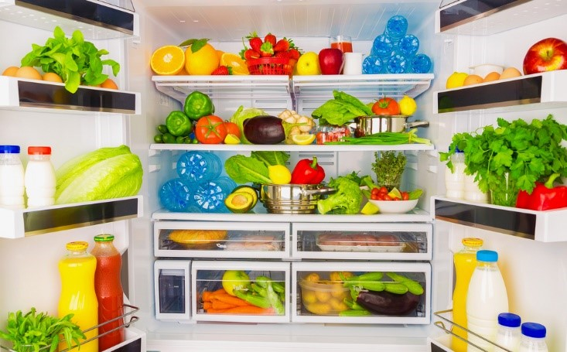

Slide 22
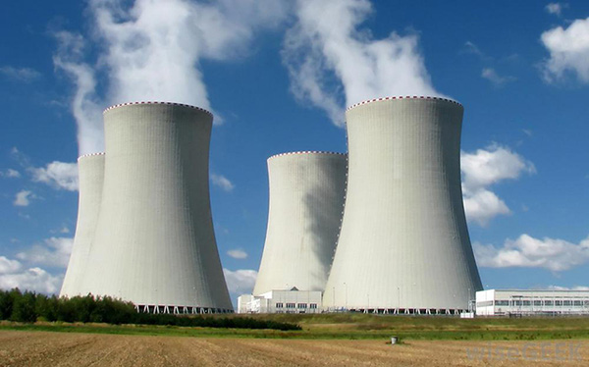

Slide 23
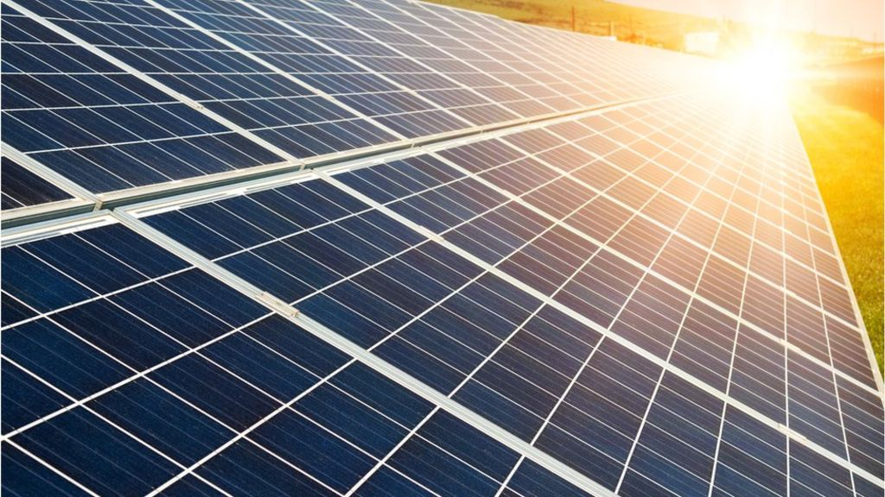

Slide 24
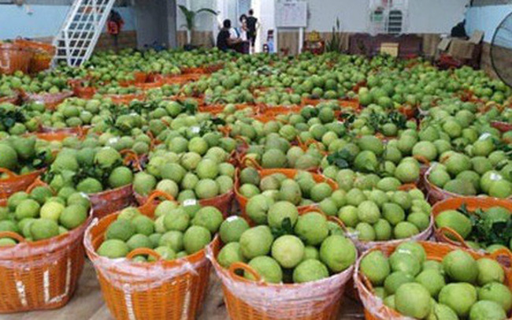

Slide 25




Thank you very much for your attendance !
Bye bye!
See you again !

